Slide 1
SunDom
Kevin Rodríguez
Diego rojas

Slide 2
introduction
The following presentation is intended to expose the most relevant details about the productive project in charge of the students Diego Rojas and Kevin Rodríguez from the San Josemaría Escrivá de Balaguer Educational Institution with an emphasis on Implementation and maintenance of industrial electronic equipment.

Slide 3
General objective
Create a home automation system capable of controlling household variables (situations) such as the switching on/off of equipment used in the background (that is not being used) and home security, in order to have efficient management of use of energy.

Slide 4
Specific objectives
Control the personalized activity of the bulbs, lights and electrical equipment in the homes through sound and / or movement sensors, in order to have an efficient consumption of electricity.
Automate an alarm system in order to detect any possible intruder inside the residences (unwanted persons) or with the purpose of identifying home accidents such as water leaks, gas leaks, or possible fires.
Develop an application through an inventor app that is capable of controlling the functions to be implemented in the home automation system through a bluetooth device with Arduino.

Slide 5
justification
The justification of the product is to generate and reinforce the comfort and safety of the people who purchase our product, in addition to the fact that our product can indirectly affect energy consumption and the useful life of electronic devices in a positive way.

Slide 6

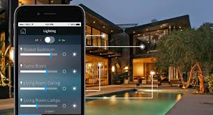
Products
Domotic System [S-D]
Security System [S-S]

Slide 7
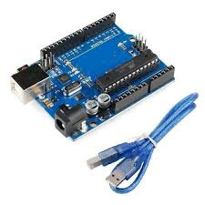
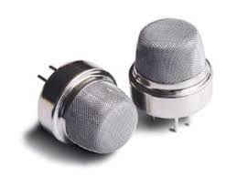

Domotic System [S-D]
It comes with an Arduino board, which will process the orders that the client sends, among which are: the control of lights, the possibility of integrating solar panels, and check if there are any type of gas leaks.

Slide 8
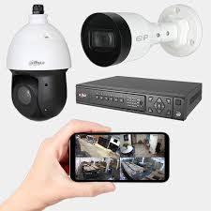
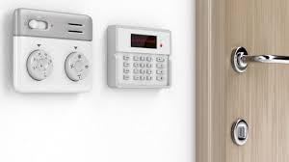
Security system [S-S]
It is also controlled by means of an Arduino board, which is in charge of alarms and security cameras, both devices located in strategic places in the house.

